Slide 1

Rajeev Gupta
Java Trainer & Consultant (MTech CS)
rgupta.mtech@gmail.com

Slide 2


Slide 3
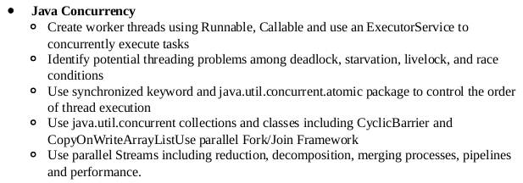

Slide 4
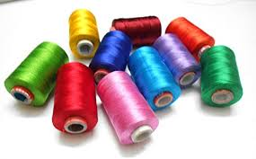
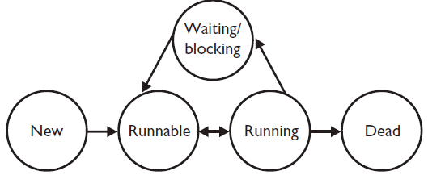

Slide 5
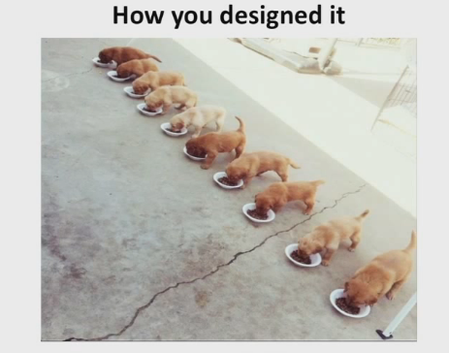


Slide 6
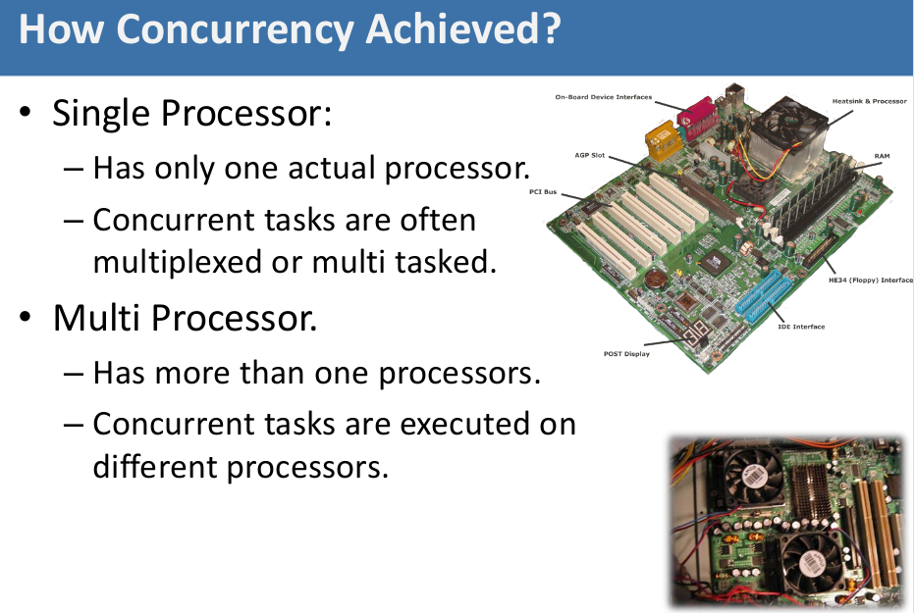

Slide 7
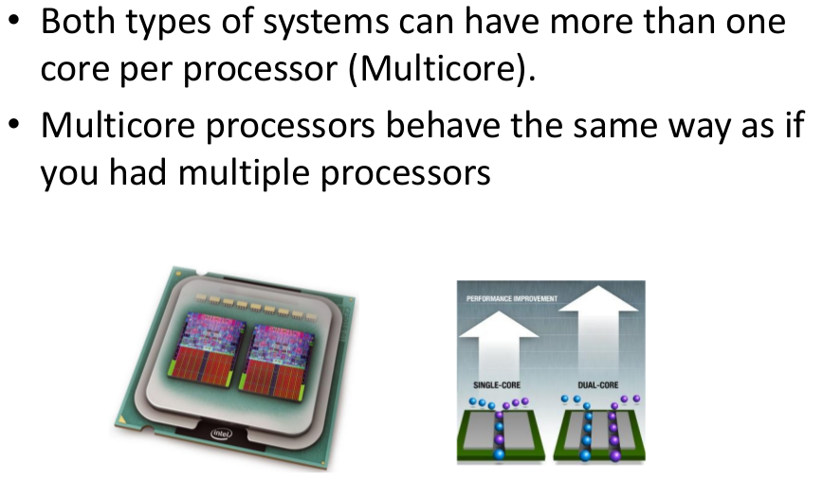

Slide 8
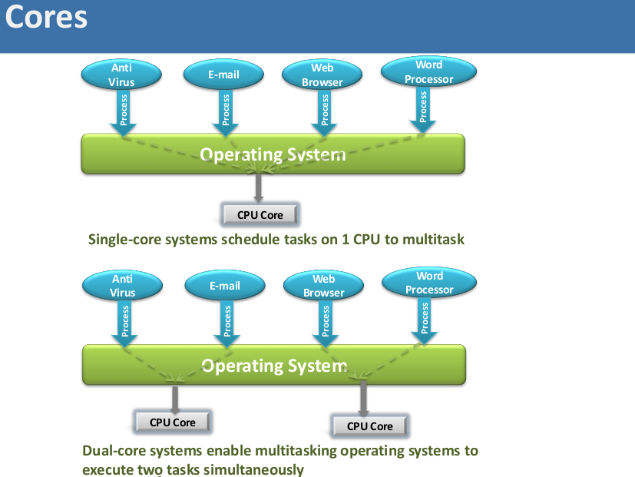

Slide 9
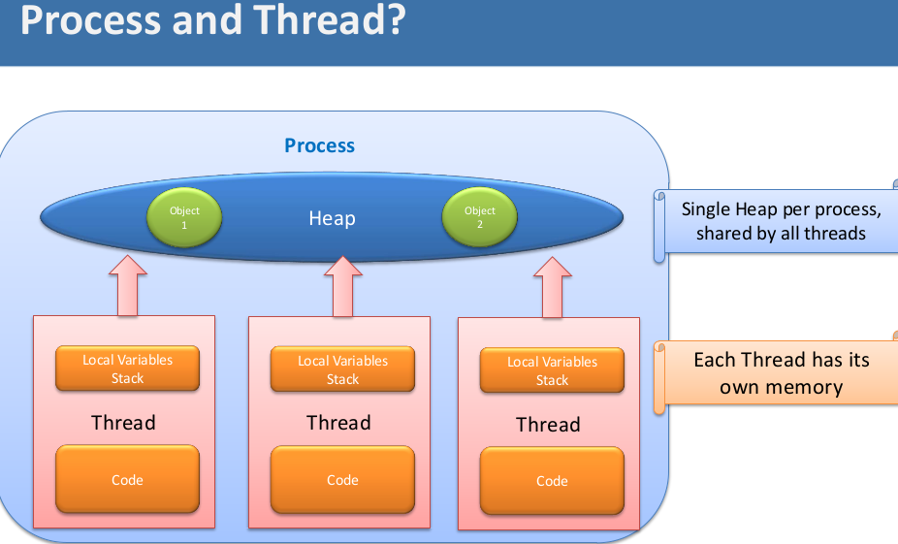

Slide 10
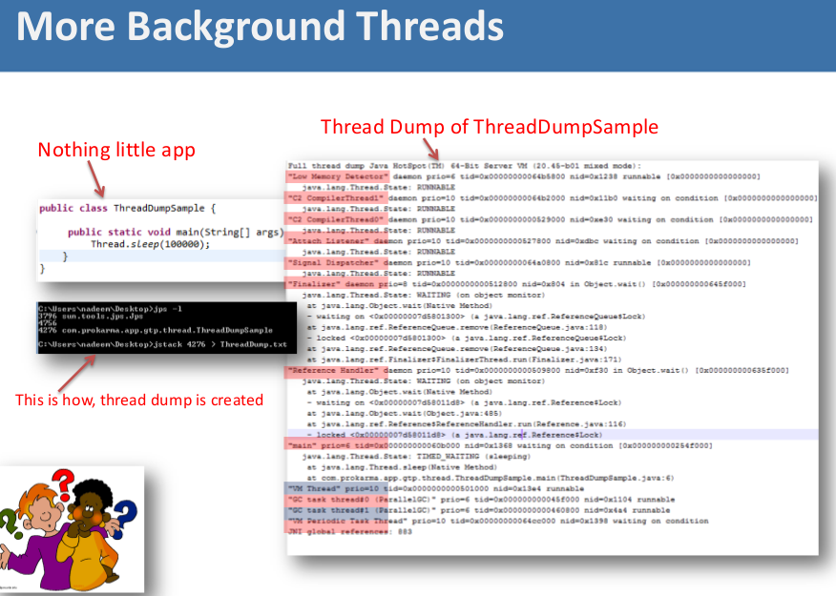

Slide 11
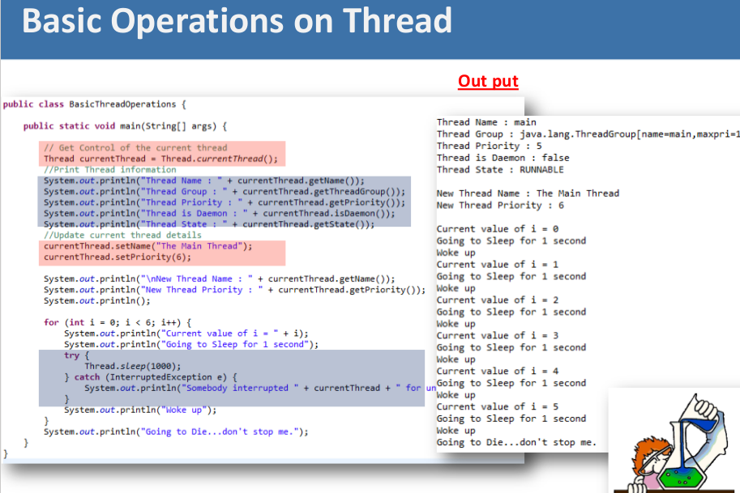

Slide 12
Let’s clarify some terms
Concurrency ≠ Parallelism
Multithreading ≠Parallelism

Slide 13
Few definitions
Concurrency: A condition that exists when at least two threads are making progress
Parallelism: A condition that arises when at least two threads are executing simultaneously
Multithreading: Allows access to two or more threads. Execution occurs in more than one thread of control, using parallel or concurrent processing
Source: Sun’s Multithreaded Programming Guide
http://dlc.sun.com/pdf/816-5137/816-5137.pdf

Slide 14


Concurrency
vs
Parallelism

Slide 15
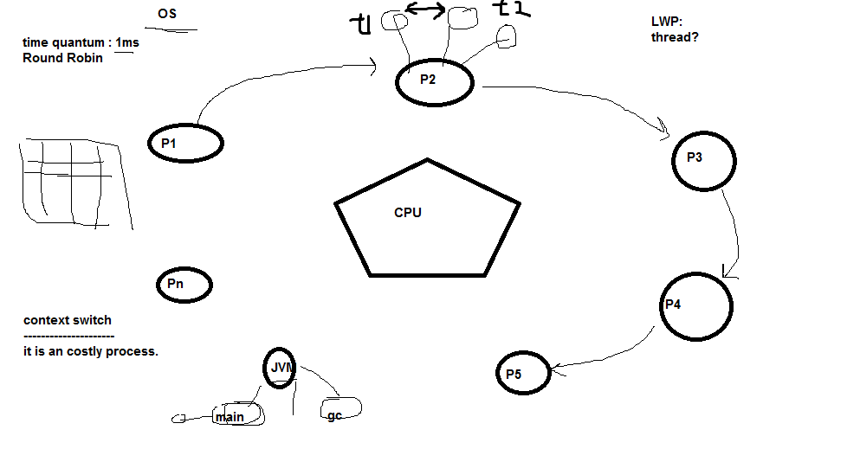
What is threads? LWP
rgupta.mtech@gmail.com

Slide 16
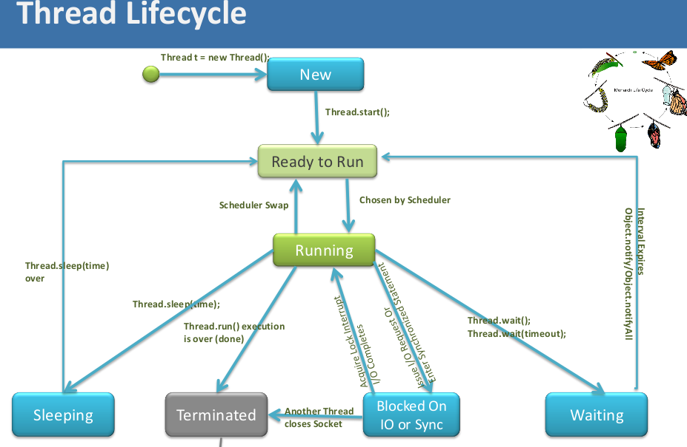

Slide 17
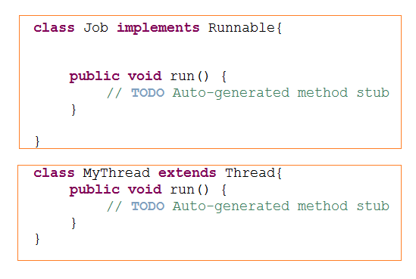
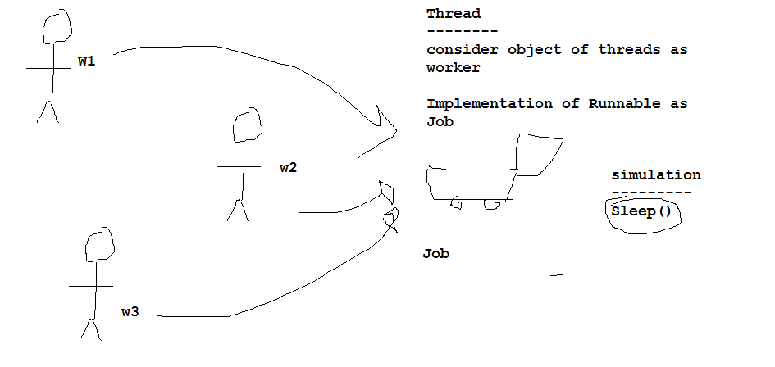
Creating threads in
Java?
Implements Runnable interface
Extending Thread class……..
Job and Worker analogy…
rgupta.mtech@gmail.com

Slide 18
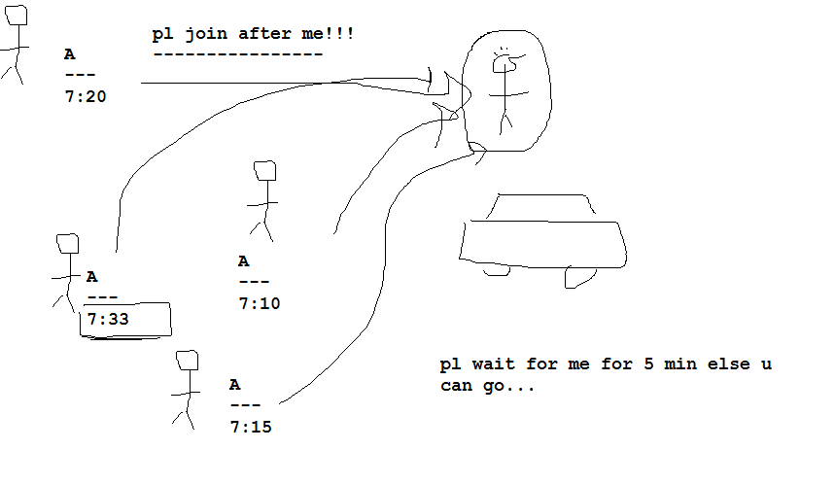

Understanding join() method
rgupta.mtech@gmail.com

Slide 19
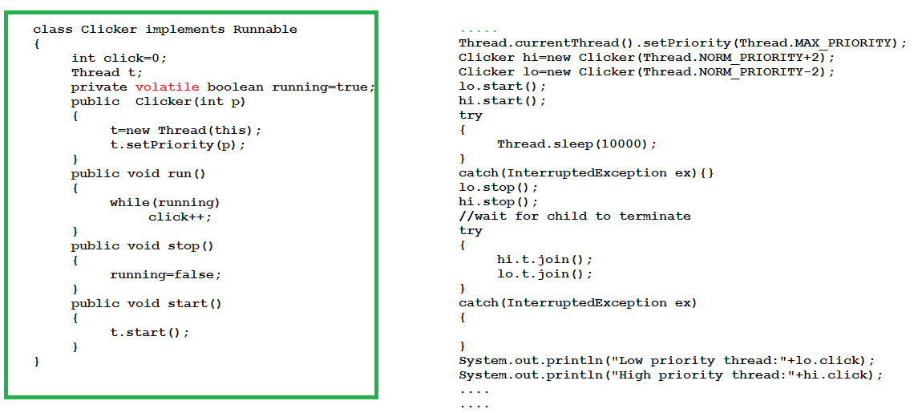
Checking thread priorities
rgupta.mtech@gmail.com

Slide 20
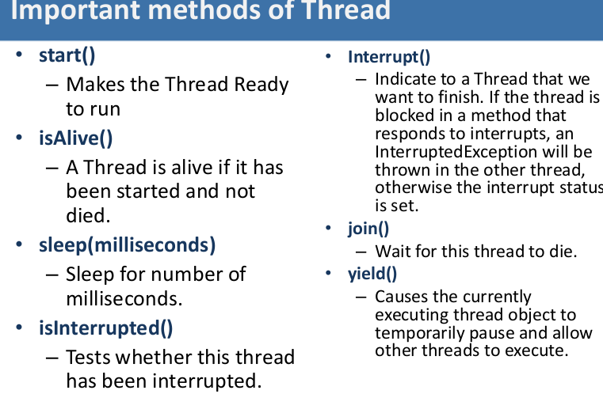

Slide 21
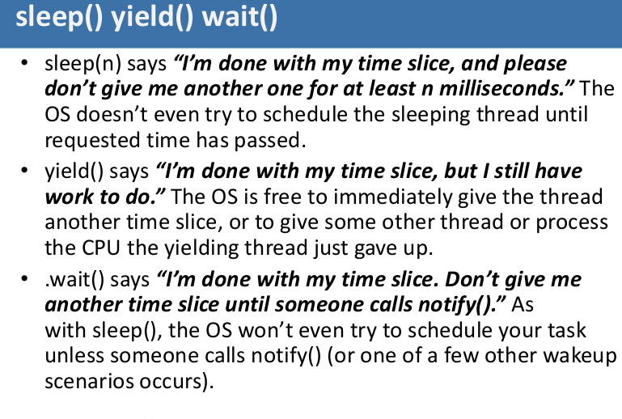

Slide 22
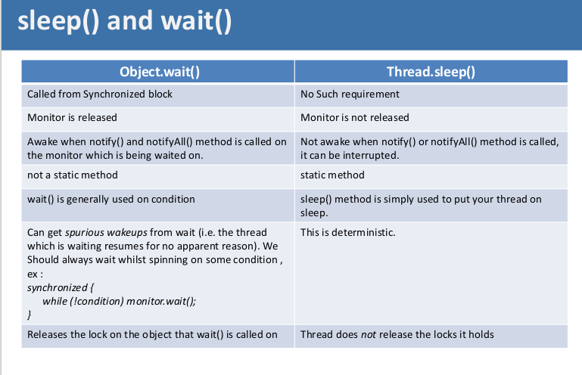

Slide 23
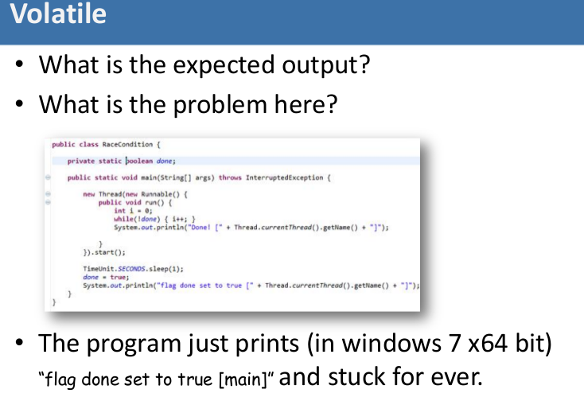
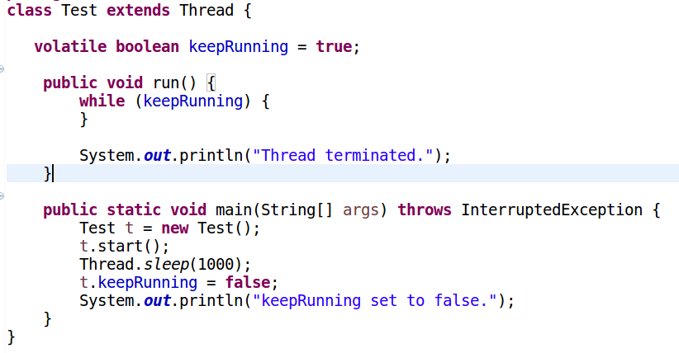

Slide 24
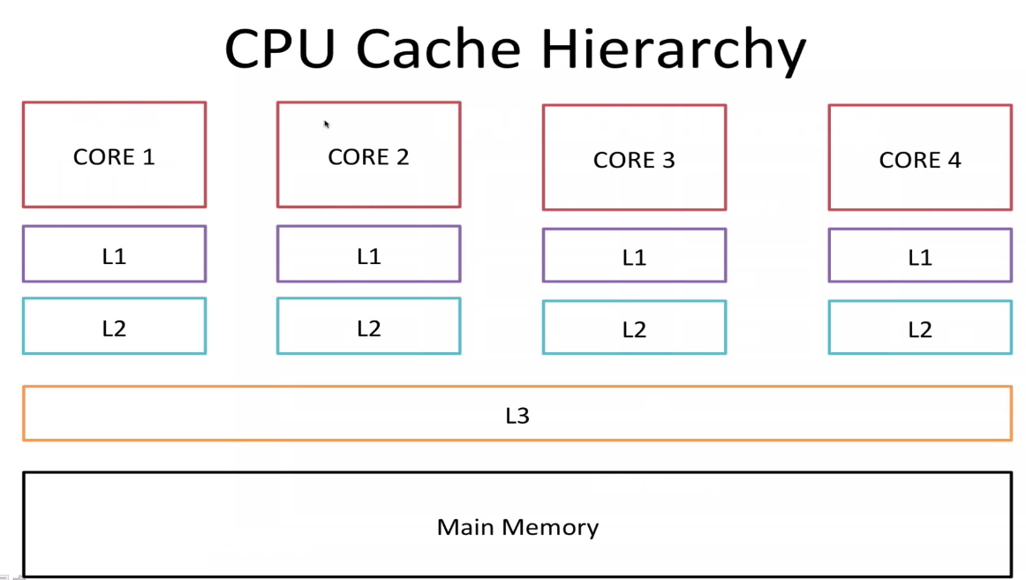
volatile
rgupta.mtech@gmail.com

Slide 25
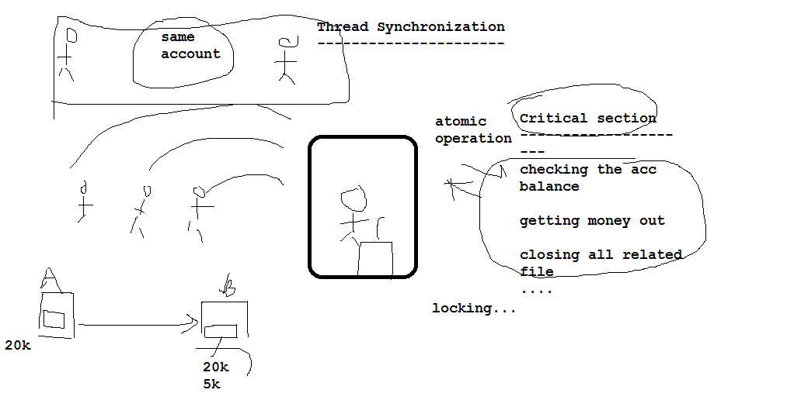
Understanding thread synchronization
rgupta.mtech@gmail.com

Slide 26
Synchronization
Synchronization
Mechanism to controls the order in which threads execute
Competition vs. cooperative synchronization
Mutual exclusion of threads
Each synchronized method or statement is guarded by an object.
When entering a synchronized method or statement, the object will be locked until the method is finished.
When the object is locked by another thread, the current thread must wait.
rgupta.mtech@gmail.com

Slide 27
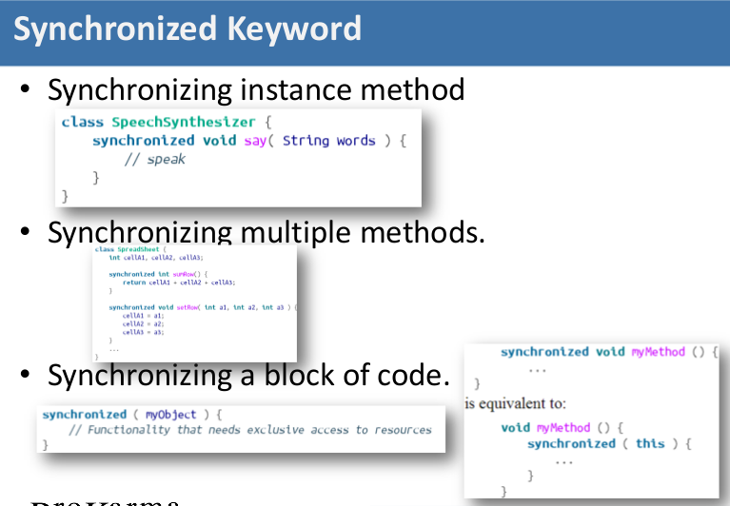

Slide 28
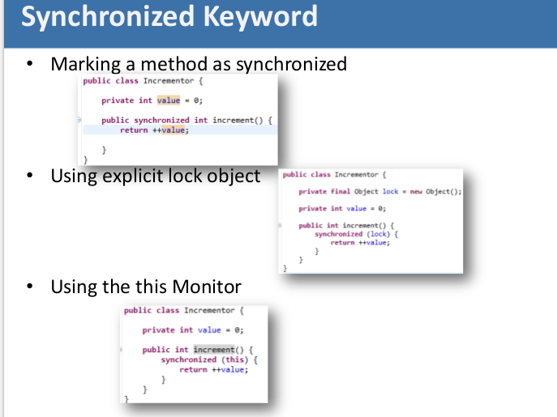

Slide 29
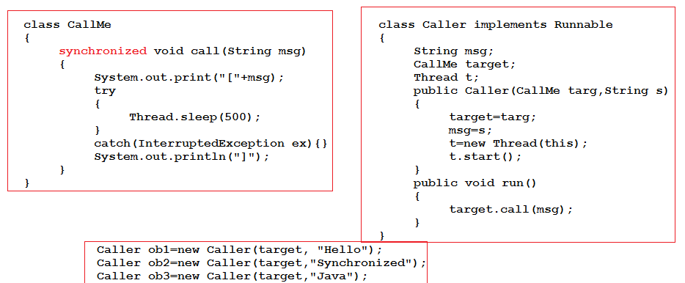
Using thread synchronization
rgupta.mtech@gmail.com

Slide 30
Inter thread communication
Java have elegant Interprocess communication using wait() notify() and notifyAll() methods
All these method defined final in the Object class
Can be only called from a synchronized context
rgupta.mtech@gmail.com

Slide 31
wait() and notify(), notifyAll()
wait()
Tells the calling thread to give up the monitor and go to the sleep until some other thread enter the same monitor and call notify()
notify()
Wakes up the first thread that called wait() on same object
notifyAll()
Wakes up all the thread that called wait() on same object, highest priority thread is going to run first
rgupta.mtech@gmail.com

Slide 32
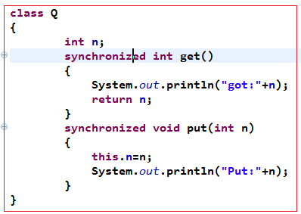
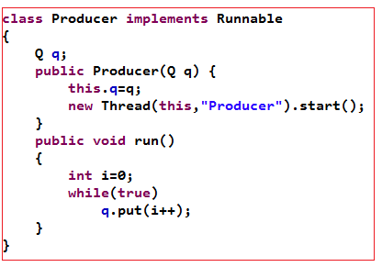
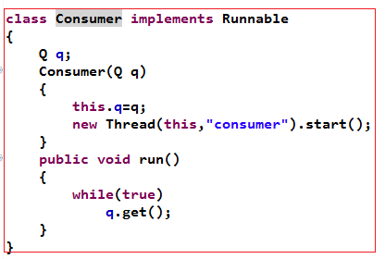
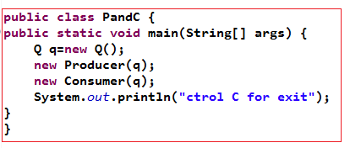
Incorrect implementation of produce consumer …
rgupta.mtech@gmail.com

Slide 33
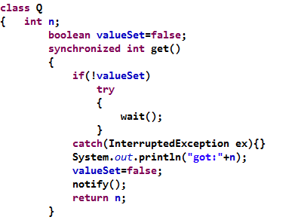
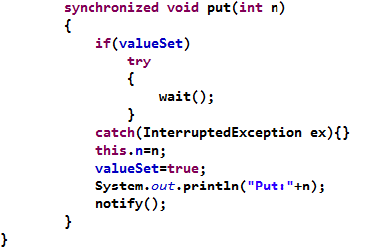
Correct implementation of produce consumer …
rgupta.mtech@gmail.com

Slide 34
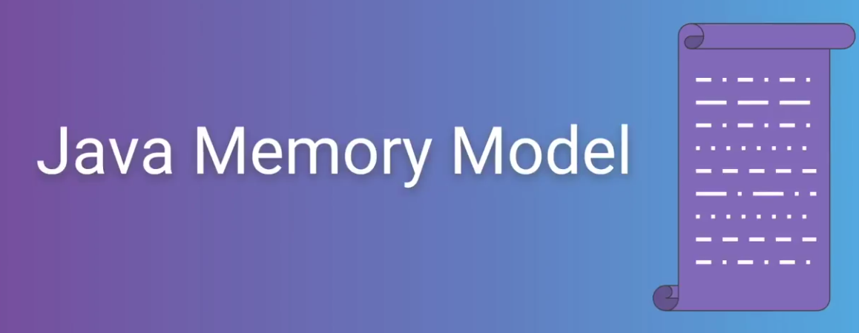

Slide 35
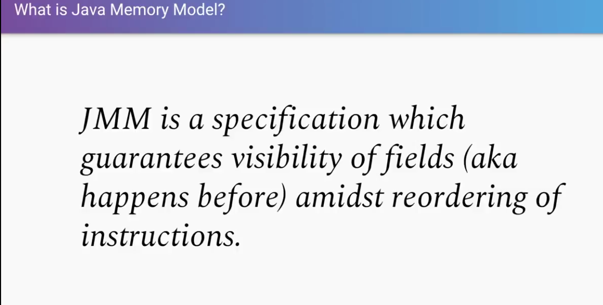

Slide 36
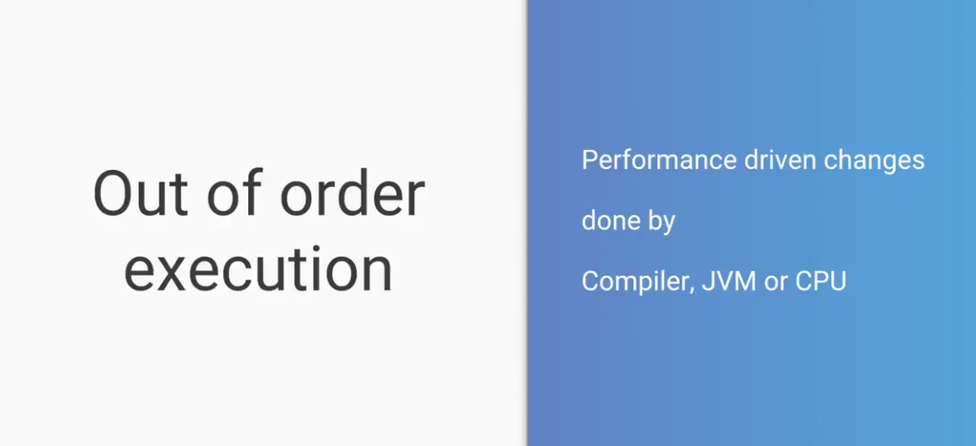

Slide 37
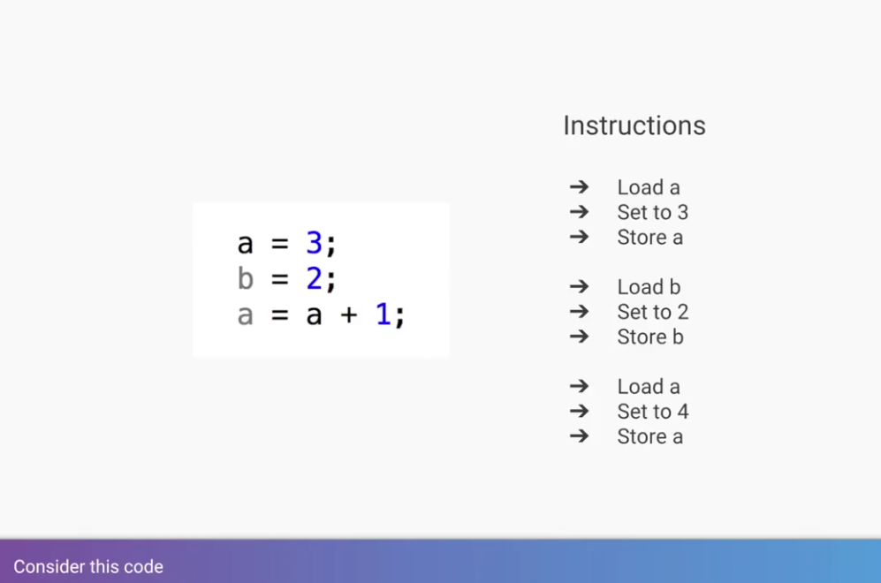

Slide 38
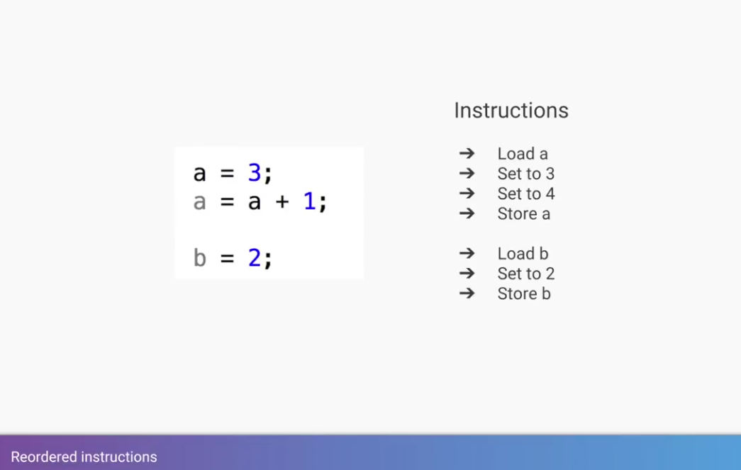

Slide 39
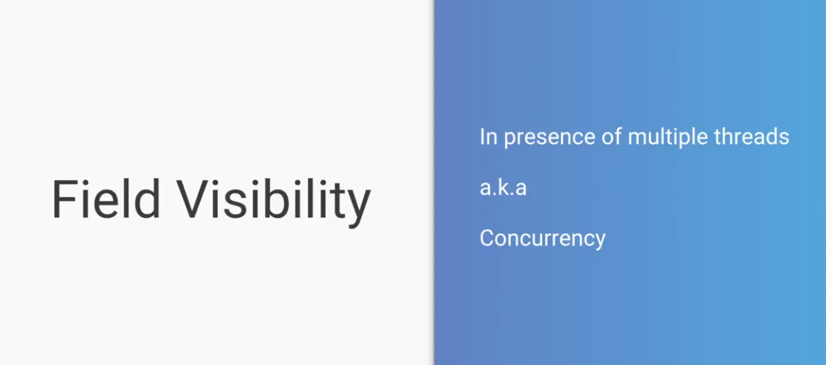

Slide 40
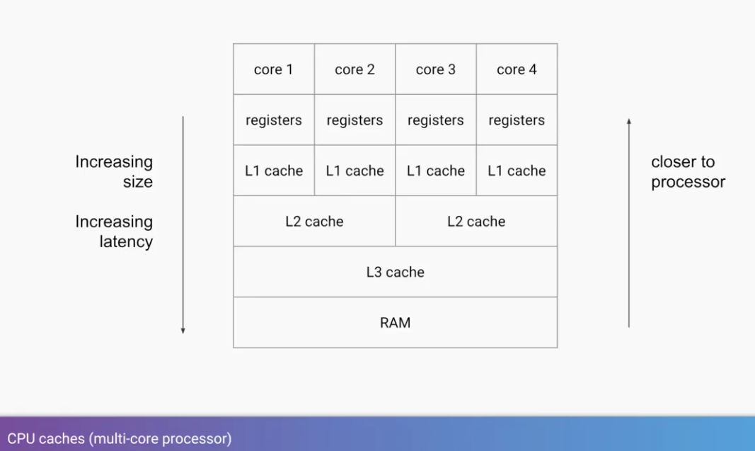

Slide 41
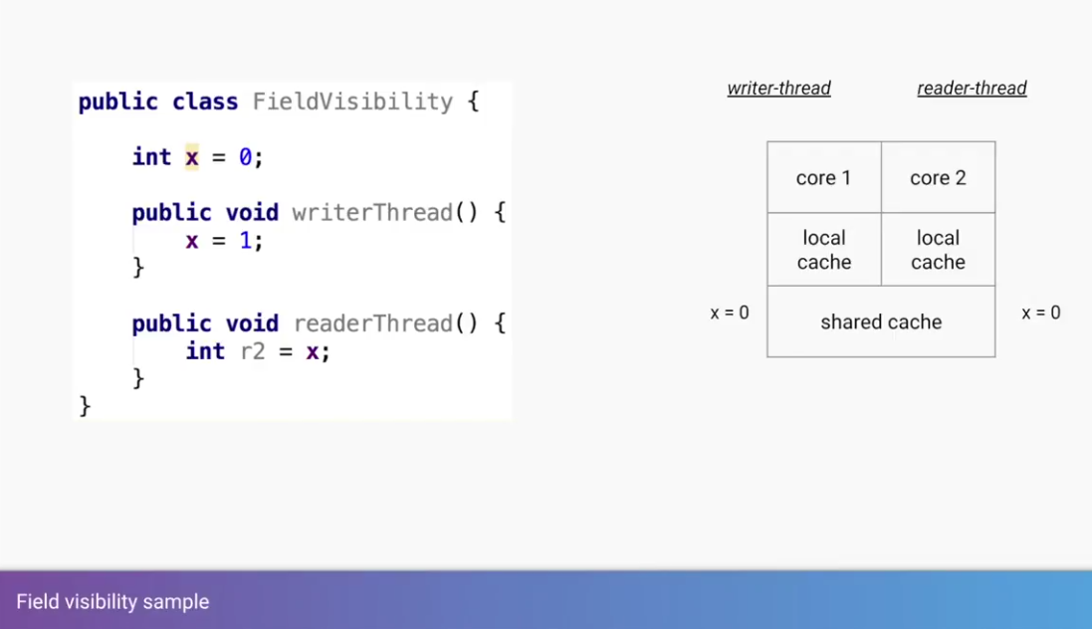

Slide 42
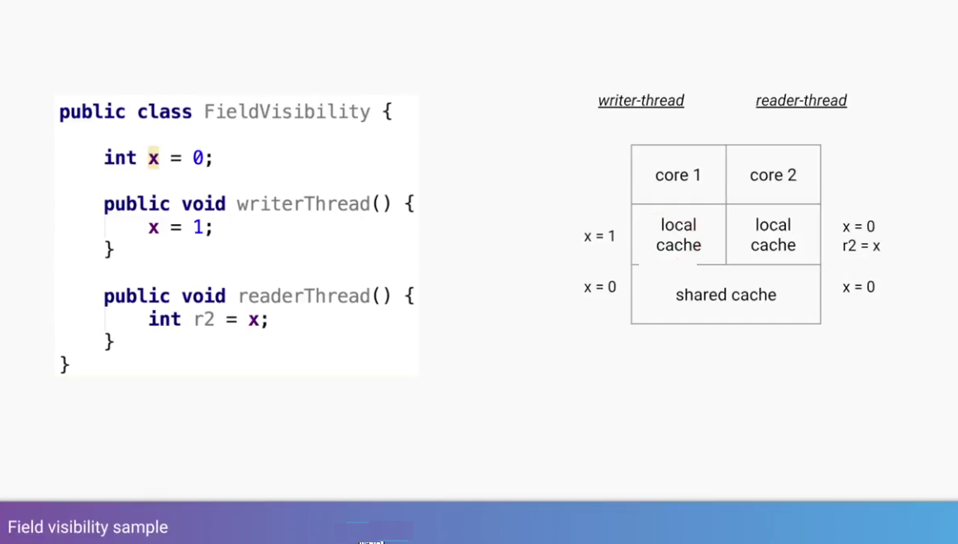

Slide 43
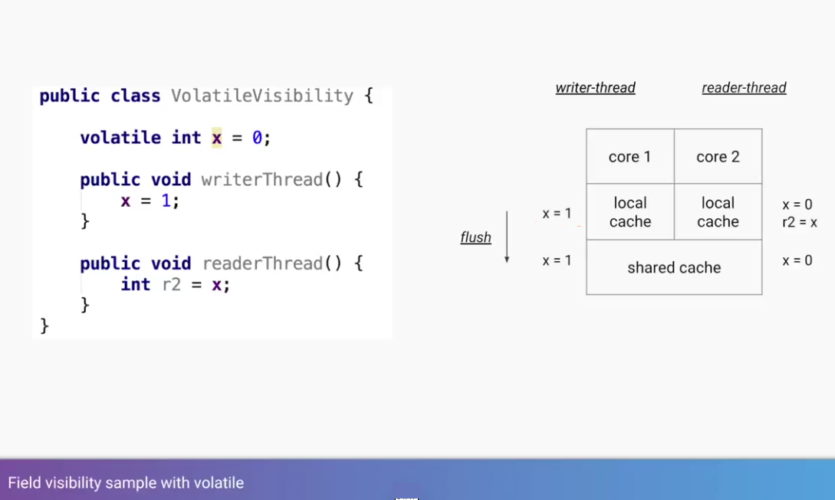

Slide 44
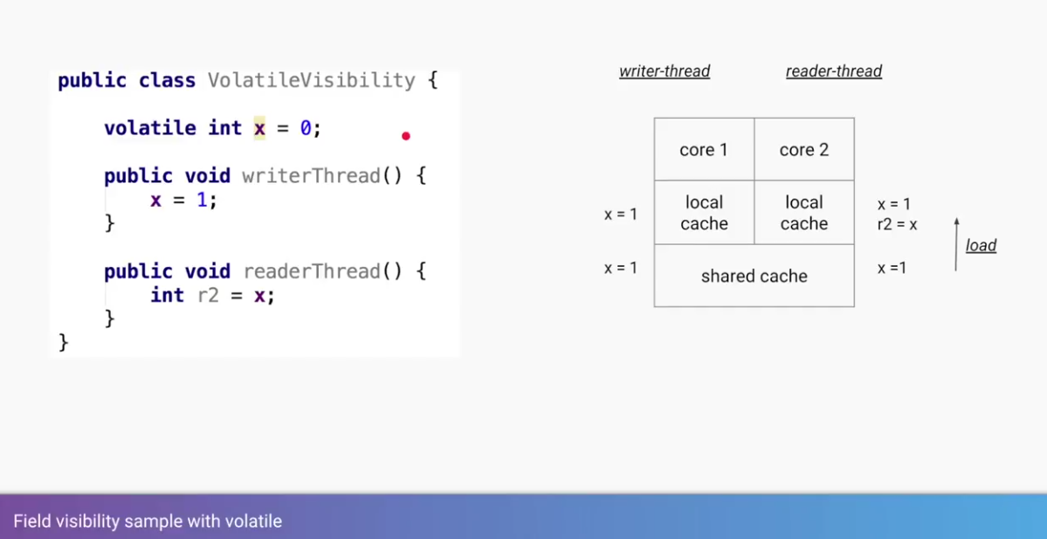

Slide 45
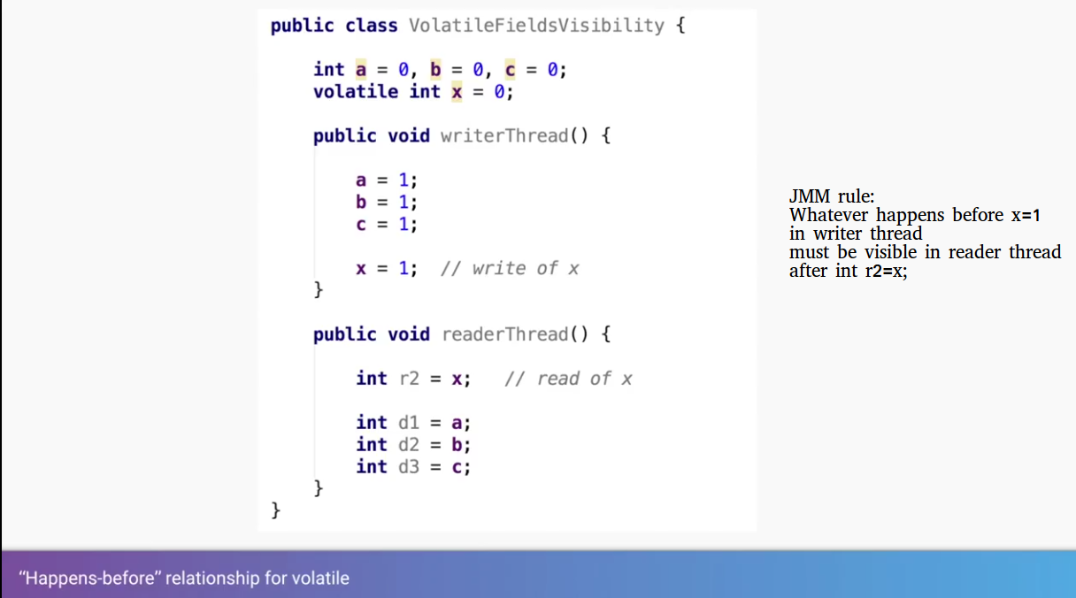

Slide 46
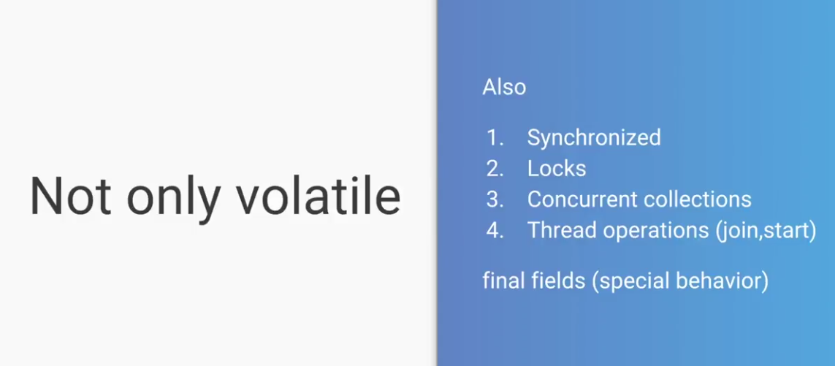

Slide 47
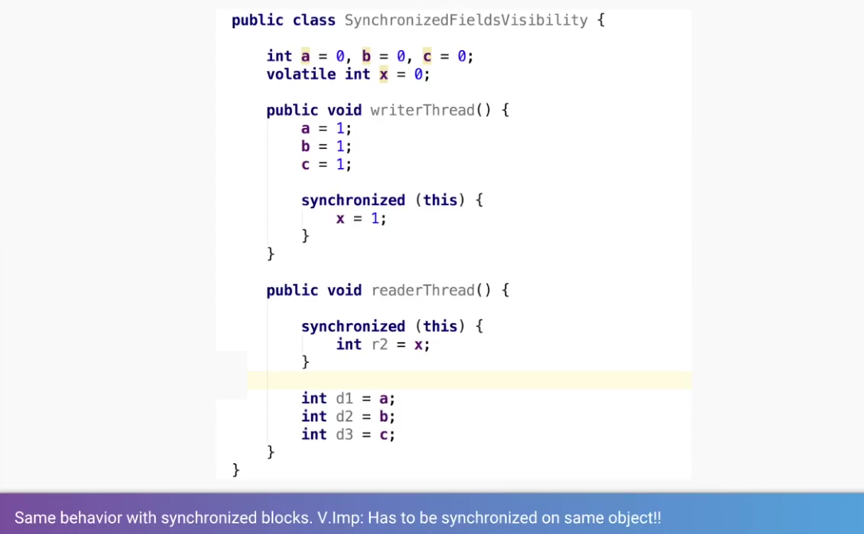

Slide 48
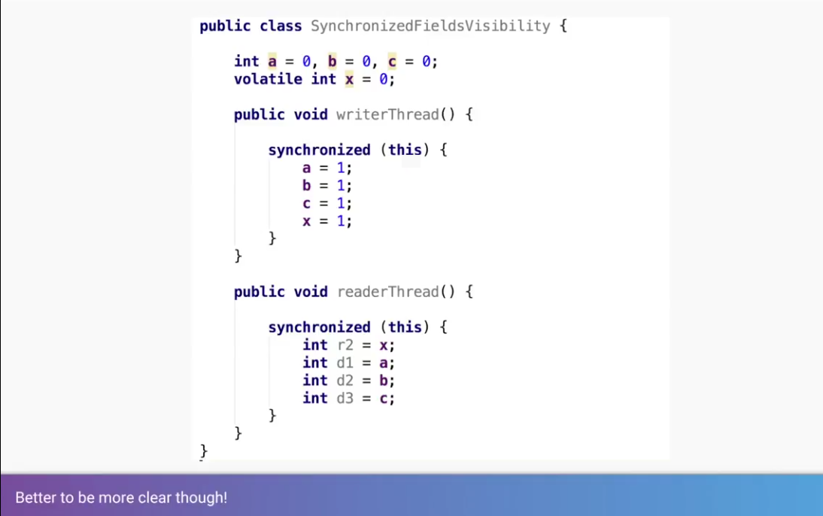

Slide 49
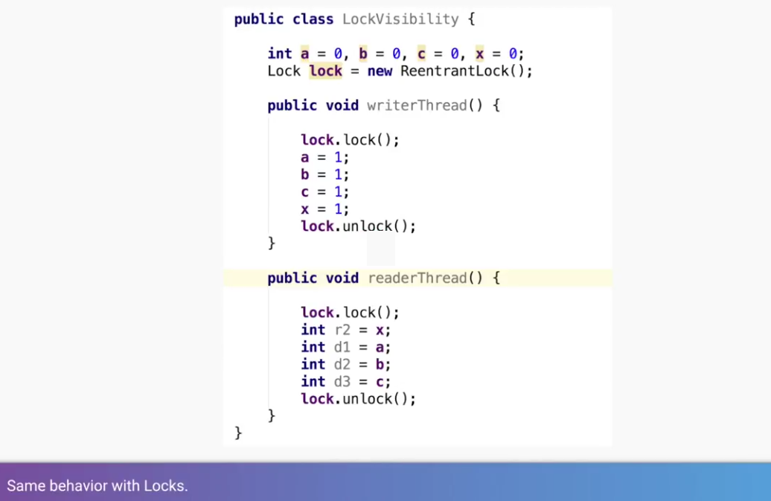

Slide 50
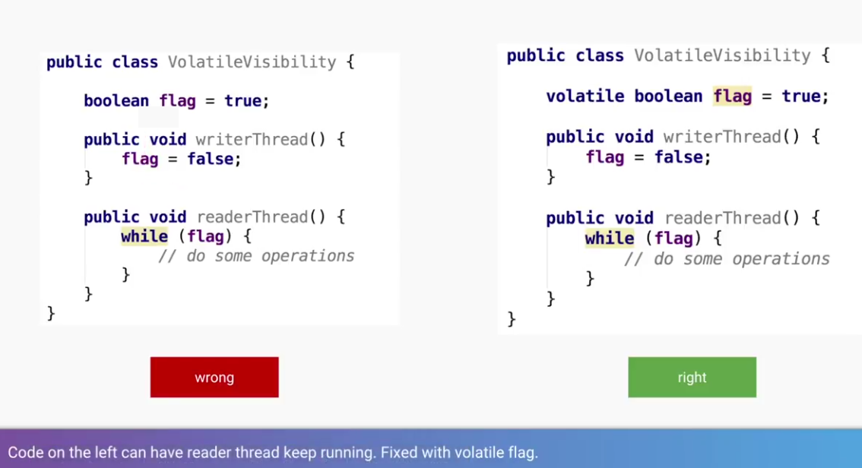

Slide 51


Slide 52
java.util.concurrency j.u.c
Introduction
Concurrency : why very active now?
Building block of concurrent application
Java concurrency –over the year
Fork join –introduction
Coding examples….
rgupta.mtech@gmail.com Java Training

Slide 53
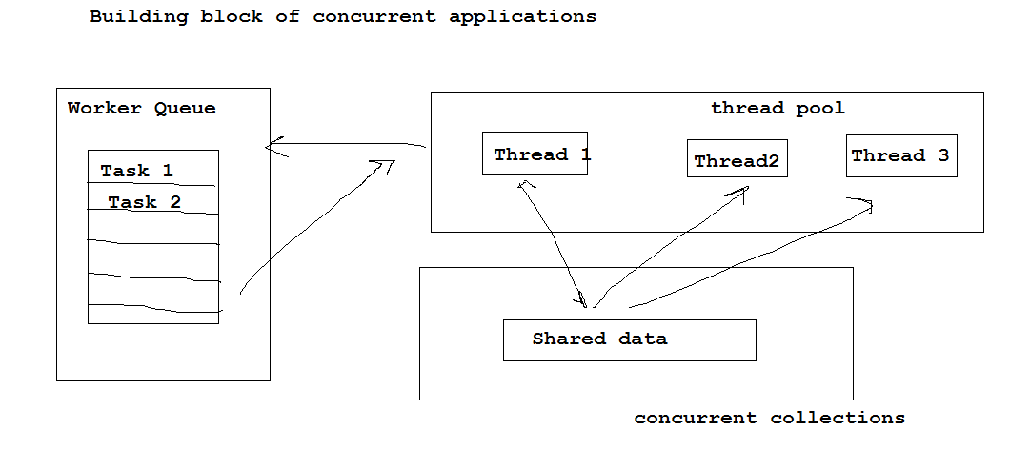
Building block of concurrent application
Thread pool
Shared data
Worker queue
rgupta.mtech@gmail.com Java Training

Slide 54
Java concurrency –Pre Java 5
Task Executor
No such framework
Runnable/Thread
No of task= no of threads
Use wait() and notify() for thread intercommunication
Collection
Vector, Hashtable
Worker queue
No framework for task dispatching
Create an thread when a task to run
Too primitive low level
High cost of thread management
Synchronization=poor performance
<<Runnable>> can not return values
rgupta.mtech@gmail.com Java Training

Slide 55
Java concurrency –Java 5
Task Executor
Executor Service Framework
Support scheduling (Timed execution)
Thread pools (lifecycle management)
Specify order of execution
Task
Object of <<Callable>> or <<Runnable>>
<<Callable>> support for asynchronous communication call() and return values
Future: hold result of processing
Collections
ConcurrentHashMap, CopyOnWriteList
Worker queue
Blocking Queue, Deque…..
Issues
No of task can’t altered at run time
Very difficult and performance intensive when applied to recursive style of problems……
rgupta.mtech@gmail.com Java Training

Slide 56
Java concurrency –Java 7
Fork join framework
For supporting a style of programming in which problem are solved recursively splitting them into subtask that are solved in parallel, waiting for them to complete and then composing results !
JSR 166 Java 7
Extend Executor framework for recursive style of problems
Implements Work stealing algorithm
Idle worker “steal” the woks from worker who are busy..
rgupta.mtech@gmail.com Java Training

Slide 57


Blocking Queue: introduction
BlockingQueue is an interface under juc package. It help to contain objects when few threads is inserting object and other threads are taking the object out of it
The threads will keep on inserting the objects unitill the max capacity of BlockingQueue is reached,after whick the threads will be blocked and they will not be able to insert further objects, threads will be in blocked state until few objects are taken out from BlockingQueue by other threads and there is space available in the blockingqueue
The threads will keep on taking the objects out from the blockingqueue until there is no object left in blockingqueue, after which the threads will be blocked and they will remain in blocked state until few objects are insertred in the blockingqueue by other threads
Use put() and take() to implement P and C
rgupta.mtech@gmail.com Java Training

Slide 58
Blocking Queue: Thread safe DS
BlockingQueue<E> is an interface with the following methods
If a queue method blocks then it stop execution of the thread until the method returns. If a method times out then the method sblocks until the time specified is reached, then the method returns.
Important implementations of BlockingQueue are
ArrayBlockingQueue, LinkedBlockingQueue, PriorityBlockingQueue and SynchronousQueue.
 | Throws exception | Special value | Blocks | Times out
Insert | add(e) | offer(e) | put(e) | offer(e,time,unit)
Remove | remove() | poll() | take() | poll(time,unit)
Examine | element() | peek() | N/A | N/A
Threads
H-

Slide 59



Slide 60

Executor framework
It separate task of creation and execution of thread
We only have to implements Runnable (Make a job) and send it to executor
Then executor is responsible for execution management
Executor maintain an thread pool
avoid continuously spawning of threads
rgupta.mtech@gmail.com Java Training

Slide 61


Slide 62


Slide 63

Executor framework Ex With <<Runnable>>
Consider Task class that contain job to be submitted to executor framework…….
rgupta.mtech@gmail.com Java Training

Slide 64


rgupta.mtech@gmail.com Java Training

Slide 65

Executor with <<Callable>>
One advantage of Executor framework that We can use <<Callable>> override call() method that can return results
<<Future>> helps us to retrieve results
rgupta.mtech@gmail.com Java Training

Slide 66

rgupta.mtech@gmail.com Java Training

Slide 67


Slide 68


Slide 69


Slide 70


Slide 71


Slide 72


Slide 73


Slide 74


Slide 75



Slide 76


Slide 77


Slide 78


Slide 79


Slide 80


Slide 81


Slide 82


Slide 83


Slide 84


Slide 85


Slide 86



Slide 87

ThreadPoolExecutor Constructor:customization

Slide 88

ThreadPoolExecutor Constructor parameters

Slide 89

ThreadPoolExecutor :understanding pool size

Slide 90

ThreadPoolExecutor :understanding pool size

Slide 91

Type of Queues used in thread pool

Slide 92

ThreadPoolExecutor :understanding Queue types

Slide 93

thread pool: handling rejections

Slide 94

thread pool: rejection policies

Slide 95

thread pool: RejectedExecutionException

Slide 96

thread pool: RejectedExecutionException

Slide 97


thread pool: Life Cycle method

Slide 98

thread pool: Example

Slide 99

thread pool: Future how it work?

Slide 100

thread pool: Blocked till all work is not done! Caution

Slide 101


Slide 102


Slide 103


Synchronization with Locks: ReentrantLock
Synchronization with Locks
More flexible
Better performance as compared to
wait() notiffy()
rgupta.mtech@gmail.com Java Training

Slide 104

Synchronization with Locks:
ReentrantReadWriteLock
ReentrantReadWriteLock has two locks
One for read
More then one thread can read
One for write
Only one thread can write
Ex: Lets consider case when one thread writing Price Information that is read by more then one reader
rgupta.mtech@gmail.com Java Training

Slide 105

ReentrantReadWriteLock
rgupta.mtech@gmail.com Java Training

Slide 106

Semaphores: use cases
rgupta.mtech@gmail.com Java Training

Slide 107

Semaphores: use cases
rgupta.mtech@gmail.com Java Training

Slide 108


Semaphores: how permit works?
rgupta.mtech@gmail.com Java Training

Slide 109


Semaphores: how permit works?
rgupta.mtech@gmail.com Java Training

Slide 110


Slide 111


Slide 112



Slide 113
Thread synchronization utilities:CountDownLatch
Waiting for multiple concurrent events
Allow one/more thread to wait until a set of operations are completed..
CountDownLatch class initialized with an integer number i.e. no of operations that thread must wait to complete before they finished
When a thread want to wait for executions of those operations, it uses await() method, it put thread to sleep until operation are complete
When one of these operation complete, it use CountDownLatchs, countDown() method to decrease the count
When it (counter ) become zero, the class wake up all the threads that sleeping in await() method
rgupta.mtech@gmail.com Java Training

Slide 114


Slide 115


Slide 116

CyclicBarrier: Use cases
Let we have a game of 3 player, we want to repeatedly send message to all 3 player without discrimination, the task run in infine loop ( repedatly), all thread threds say barrier.await() ( all can do in different time) , all three thread need to wait then when all arived then they continue processing
rgupta.mtech@gmail.com Java Training

Slide 117


Slide 118


Thread safe DS java

Slide 119


Slide 120

Fork-Join framework

Slide 121

Fork Join Framework
Parallel version of Divide and Conquer
Recursively break down the problem into sub problems
Solve the sub problems in parallel
Combine the solutions to sub-problems to arrive at final result
General Form

Slide 122
Java library for Fork–Join framework
Started with JSR 166 efforts
JDK 7 includes it in java.util.concurrent
Can be used with JDK 6.
Download jsr166y package maintained by Doug Lea
http://gee.cs.oswego.edu/dl/concurrency-interest/

Slide 123
Java library for Fork–Join framework
Started with JSR 166 efforts
JDK 7 includes it in java.util.concurrent
Can be used with JDK 6.
Download jsr166y package maintained by Doug Lea
http://gee.cs.oswego.edu/dl/concurrency-interest/

Slide 124
Fork-Join framework

Slide 125

Selecting a max number
Sequential algorithm

Slide 126

Selecting max with Fork-Join framework
A Fork-Join Task
Solve sequentially if problem is small
Otherwise Create sub tasks & Fork
Join the results

Slide 127
Fork-Join framework implementation
Basic threads (Thread.start() , Thread.join())
May require more threads than VM can support
Conventional thread pools
Could run into thread starvation deadlock as fork join tasks spend much of the time waiting for other tasks
ForkJoinPool is an optimized thread pool executor (for fork-join tasks)

Slide 128
Fork-Join framework implementation
Basic threads (Thread.start() , Thread.join())
May require more threads than VM can support
Conventional thread pools
Could run into thread starvation deadlock as fork join tasks spend much of the time waiting for other tasks
ForkJoinPool is an optimized thread pool executor (for fork-join tasks)

Slide 129

ForkJoinTask as is could improve performance…
However some boilerplate work is still needed. Is there a better way?
i.e. declarative specification of parallelization
There is a better way

Slide 130

Options for Transparent Parallelism
ParallelArray
ForkJoinPool with an array
Versions for primitives and objects
Provide parallel aggregate operations
Can be used on JDK 6+ with extra166y package from http://gee.cs.oswego.edu/dl/concurrency-interest/

Slide 131

Example: ParallelArray Operations
ParallelArray created with ForkJoinPool
A filter operation
A map operation
SQL like.. Batches operations in a single parallel step
Select max is a single step

Slide 132


Lambda’s make life easier..
With Lambda’s

Slide 133
Fork-Join and Map-Reduce
 | Fork-Join | Map-Reduce
Processing on | Cores on a single compute node | Independent compute nodes
Division of tasks | Dynamic | Decided at start-up
Inter-task communication | Allowed | No
Task redistribution | Work-stealing | Speculative execution
When to use | Data size that can be handled in a node | Big Data
Speed-up | Good speed-up according to #cores, works with decent size data | Scales incredibly well for huge data sets
Source: http://www.macs.hw.ac.uk/cs/techreps/docs/files/HW-MACS-TR-0096.pdf

